Slide 1
Solar irradiation prediction

Slide 2
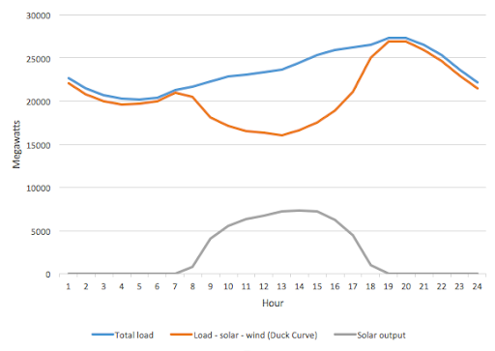
Background
Prediction of solar irradiance is essential for minimizing energy costs and providing high power quality in electrical power grids with distributed solar photovoltaic generations. However, for residential and small commercial users deploying on-site photovoltaic generations, the historical irradiance data can not be obtained directly because of expensive solar irradiance meters. Thanks to increasingly improved weather forecasting service provided by local meteorological organizations, weather forecasting data such as temperature, dew point, humidity, visibility, wind speed and descriptive weather summary, are becoming readily available through the Internet, while the irradiance forecasting data are often unavailable.
According to the proposed regulations, wind and solar power generators will not have to pay penalties for up to 10% deviation in scheduling power. For deviation beyond 10%, they will have to pay charges at 10% of the normal rate.
There is a need to predict solar power generation as passing clouds would cause power plants to quickly ramp up / ramp down to match the electrical demand.

Slide 3
Show data from where

Slide 4
Plot some graphs and prediction curve
Cloud type
RH

Slide 5
End product is what?
An app that regularly calls current weather API or even weather forecasts and predict the irradiance.

